Slide 1
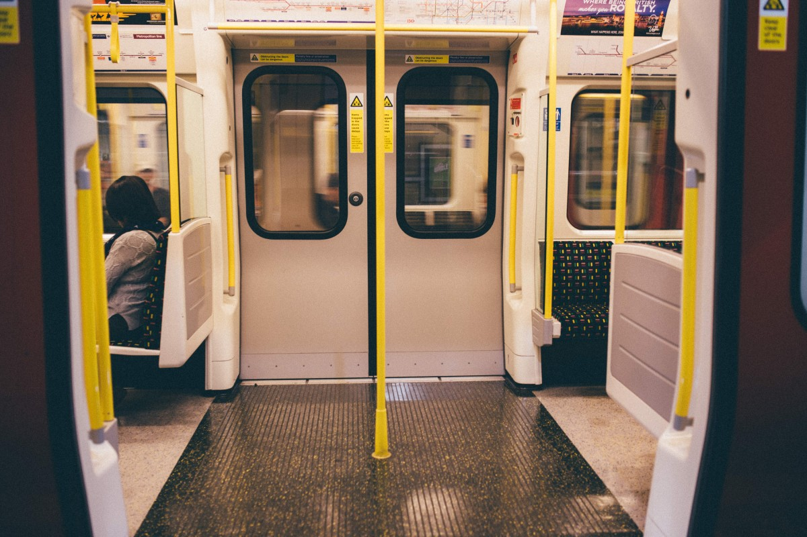

TRACQR
Sanya Wadhawan - E23CSEU0872
Kartik Bansal - E23CSEU0884
Batch - 30, Group – 4

Slide 2
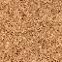
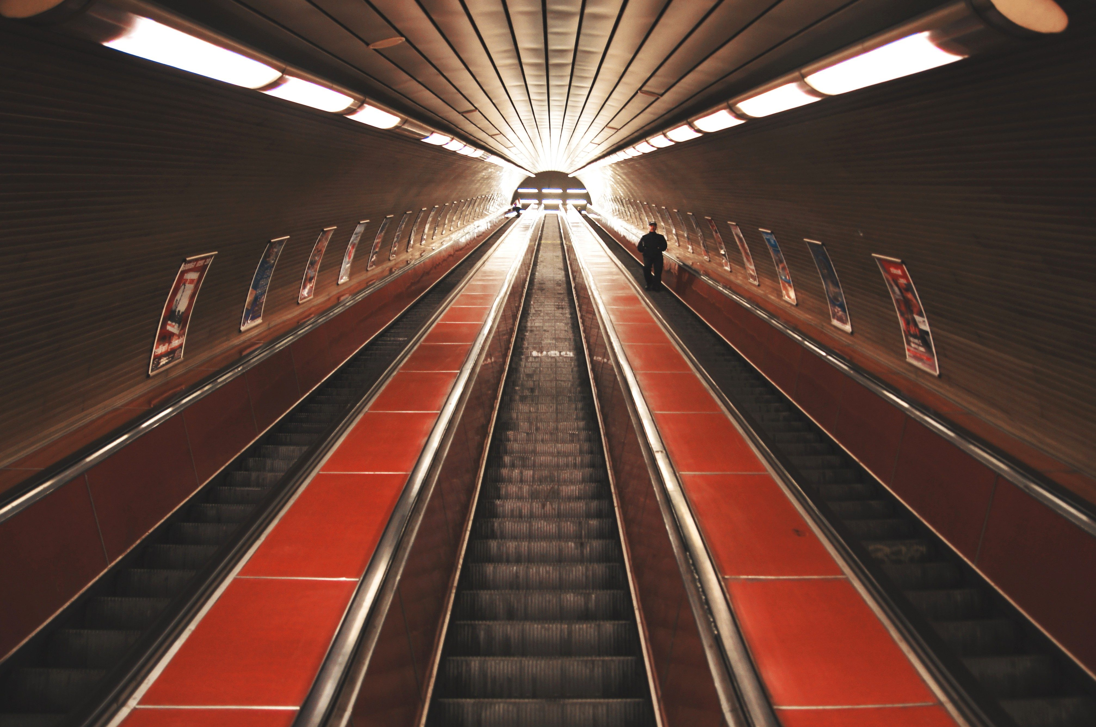
IDEA
This website provides a platform for passengers to:
Easily locate their nearest metro stations,
Provide a GPS featured map of metro lines,
Book their tickets through online payment,
Keep easy track of a single QR for each checkpoint,
Make the onboarding process effortless and quick.

Slide 3

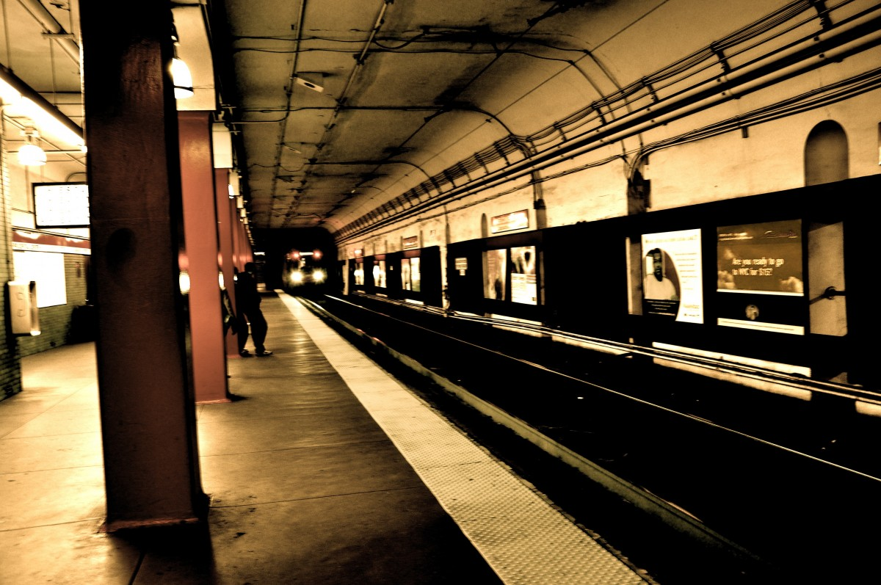
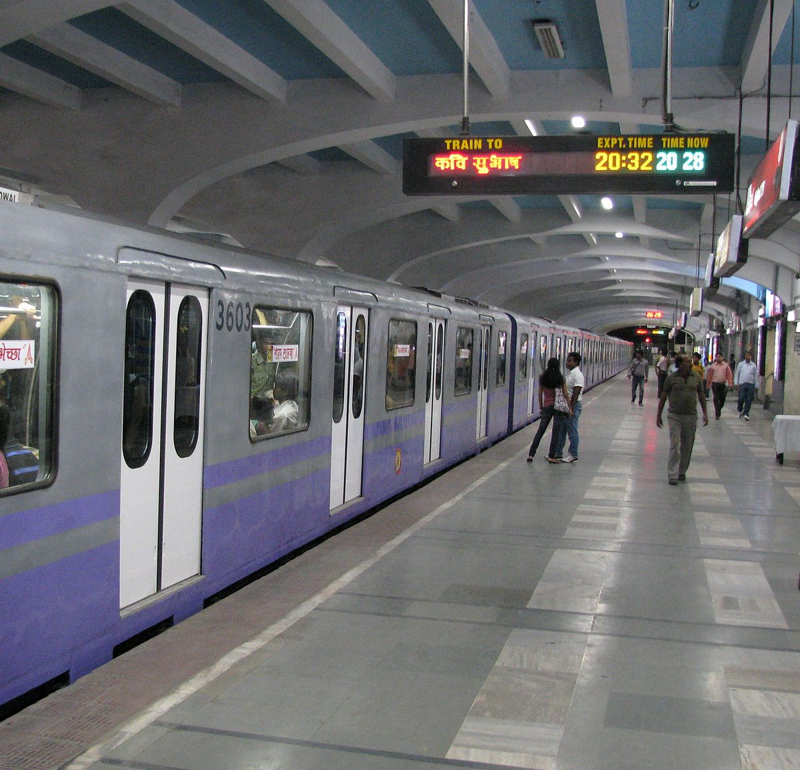
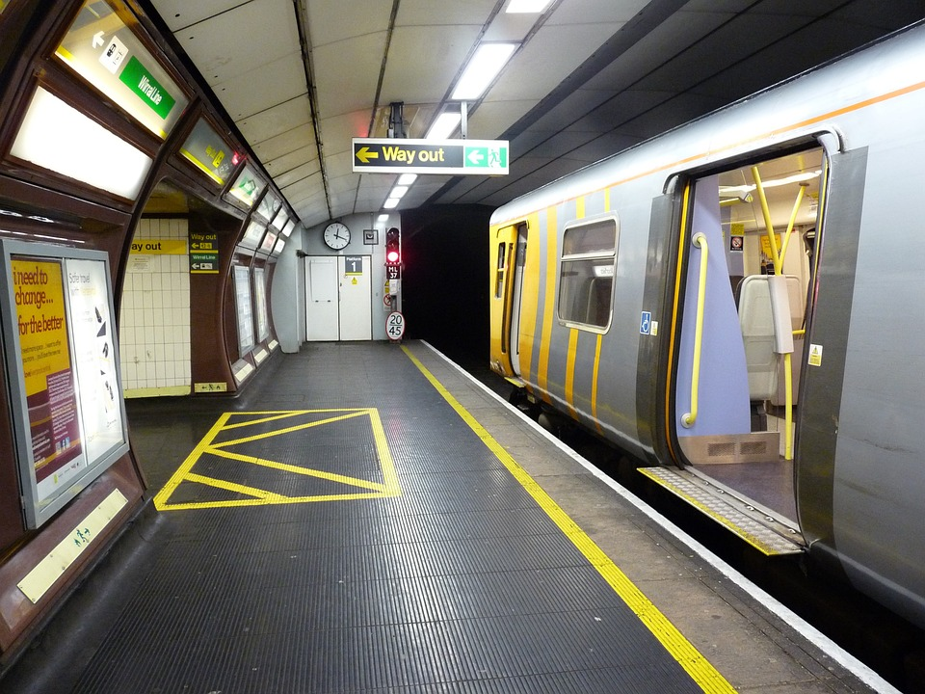
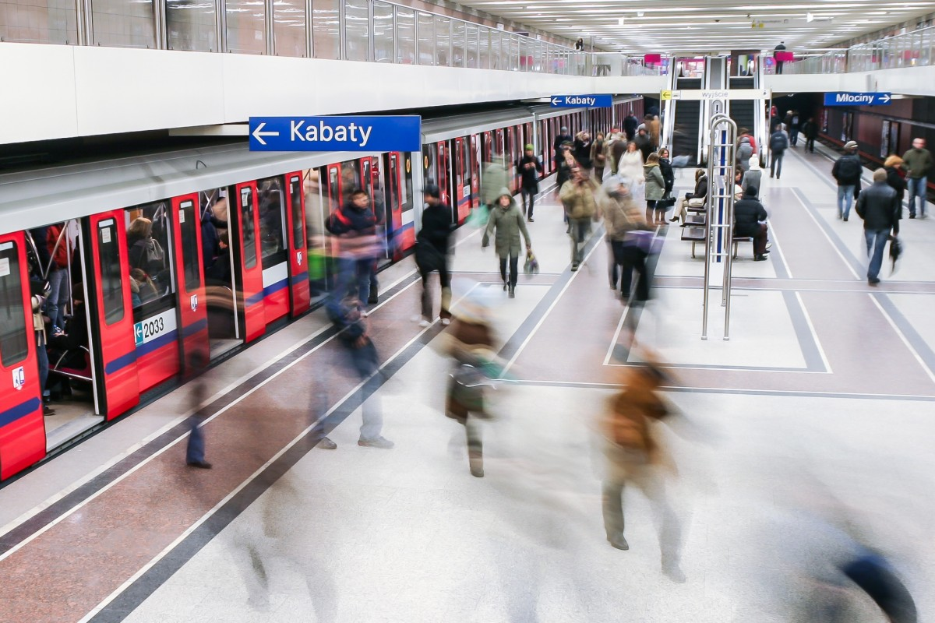

APPLICATION
Integrated all in one guide for tourists and travellers alike.
Less wait time at stations.
Ease of use and digitalized system.
Accessibility at an instant in your hands.
Confusion-free solution to route finding.

Slide 4


MEMBERS AND RESPONSIBILITIES
SANYA WADHAWAN
KARTIK BANSAL
FRONT END INCLUDING HTML, CSS
PRESENTATION
FLASK IN BACKEND
FIGMA DESIGNS
BACK END INCLUDING DATABASE
PYTHON IN BACKEND

Slide 5


A basic template video showcasing our project’s application features.

Slide 6
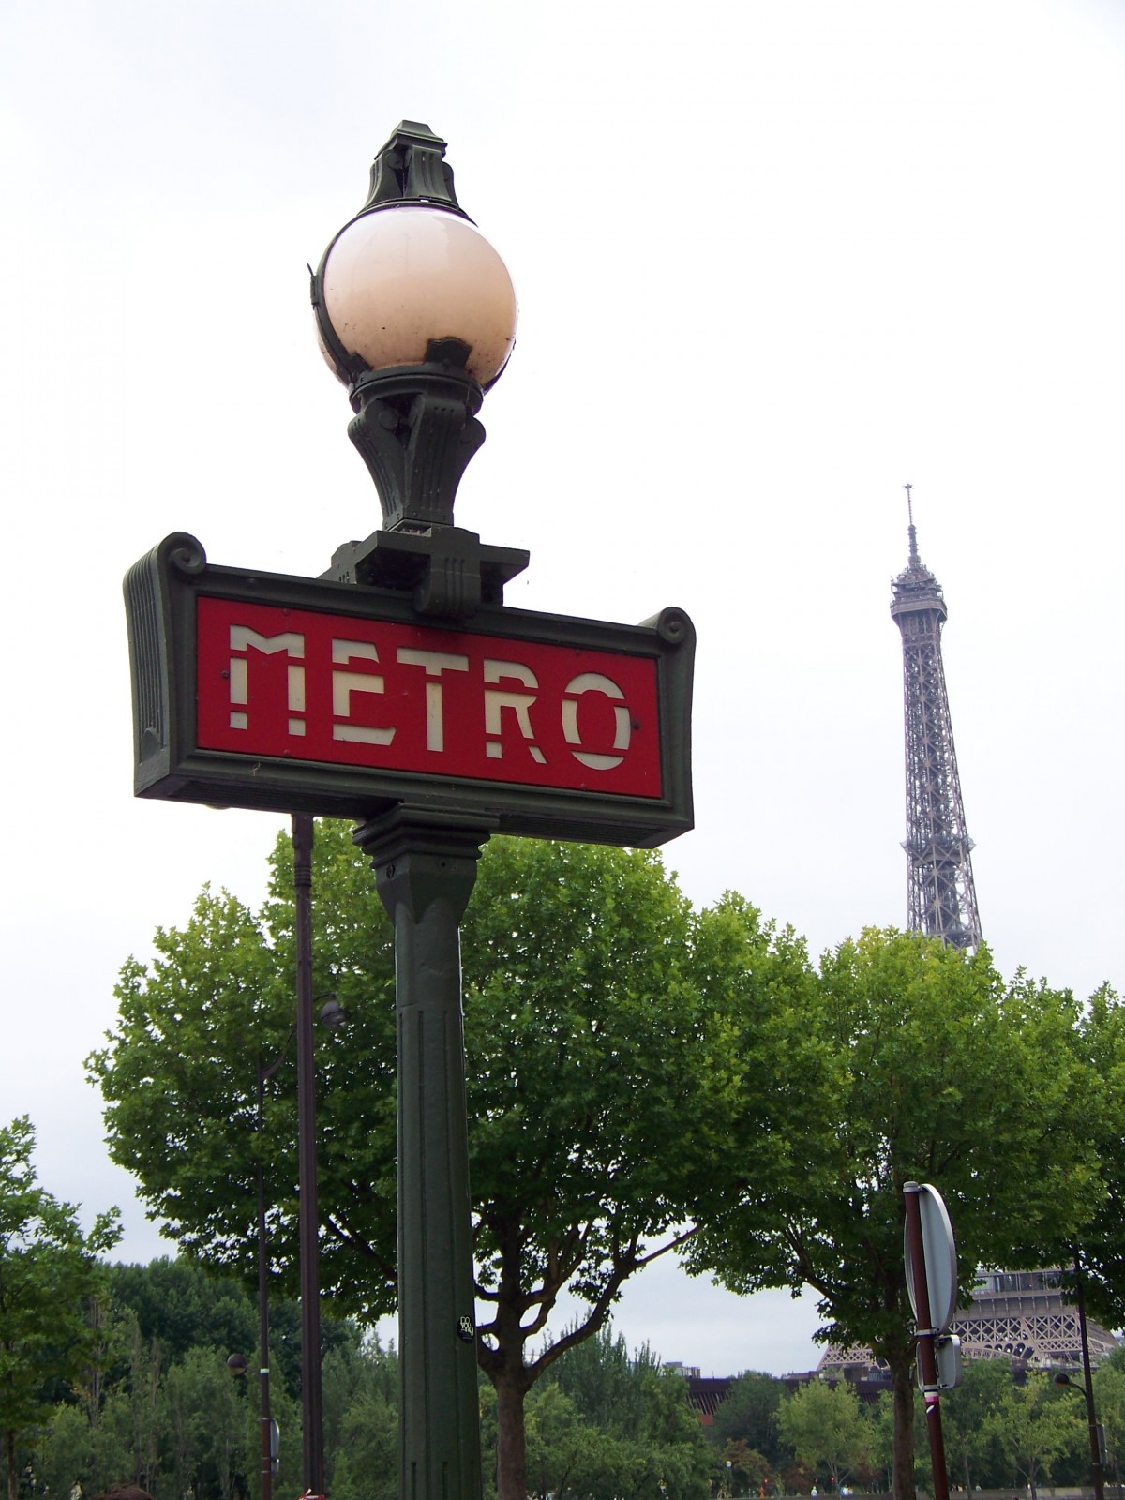
THANK YOU!
A WORD OF ACKNOWLEDGEMENT FOR OUR TEACHERS for their UNWAVERING support AND GUIDANCE THAT INSPIRES US EVERY STEP OF THE WAY.

